Slide 1


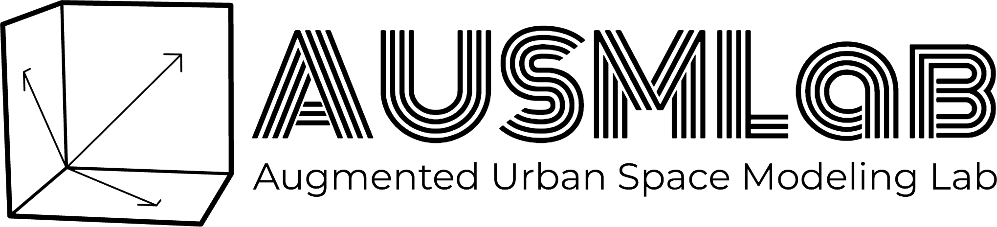
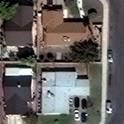
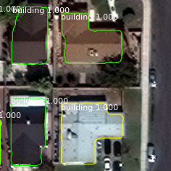
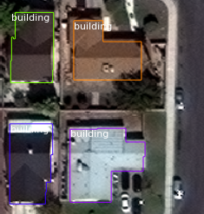
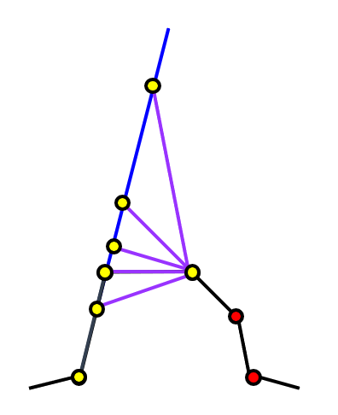
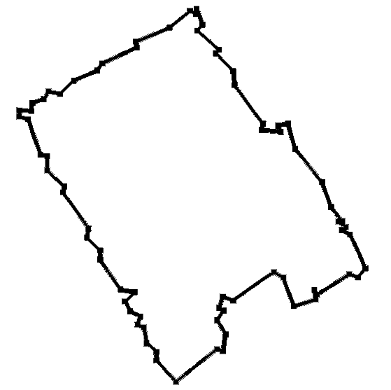
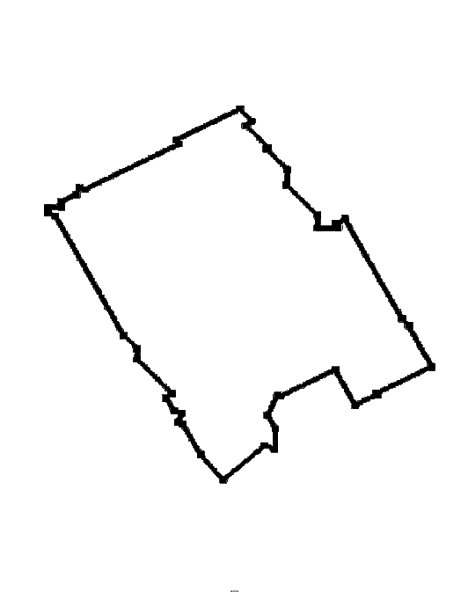
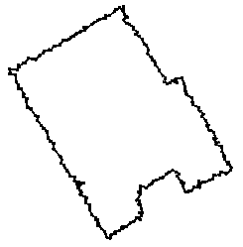
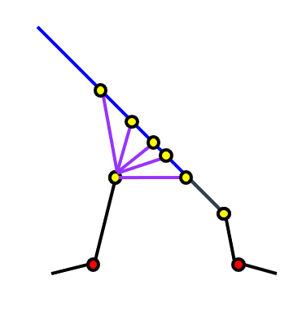
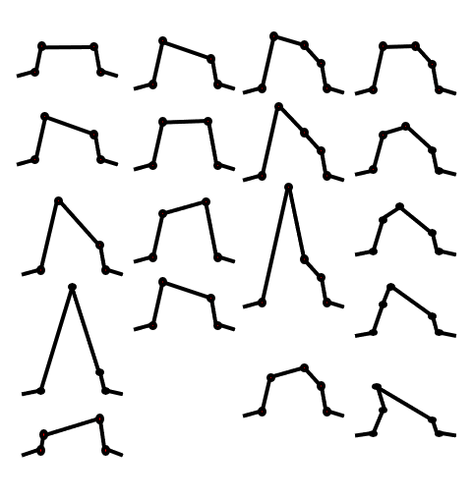
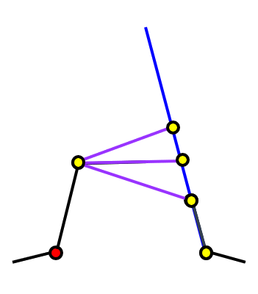
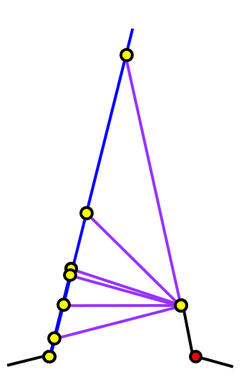
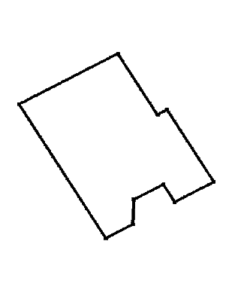
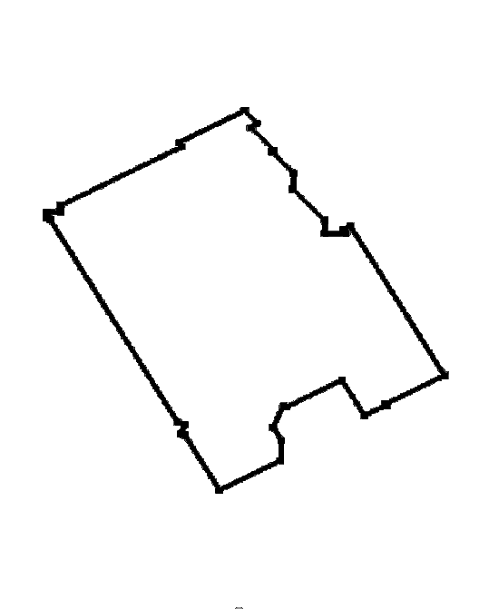
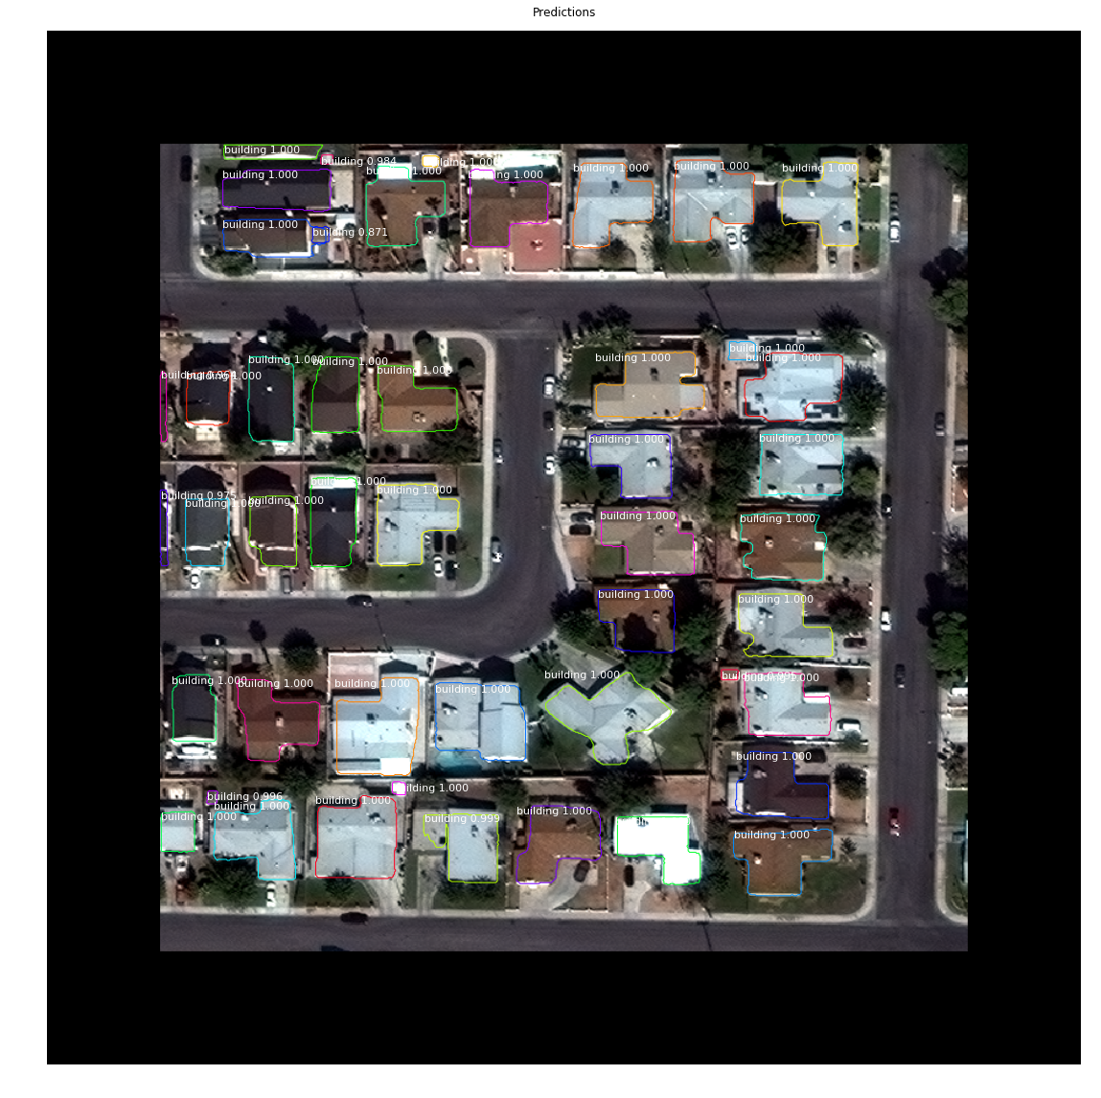
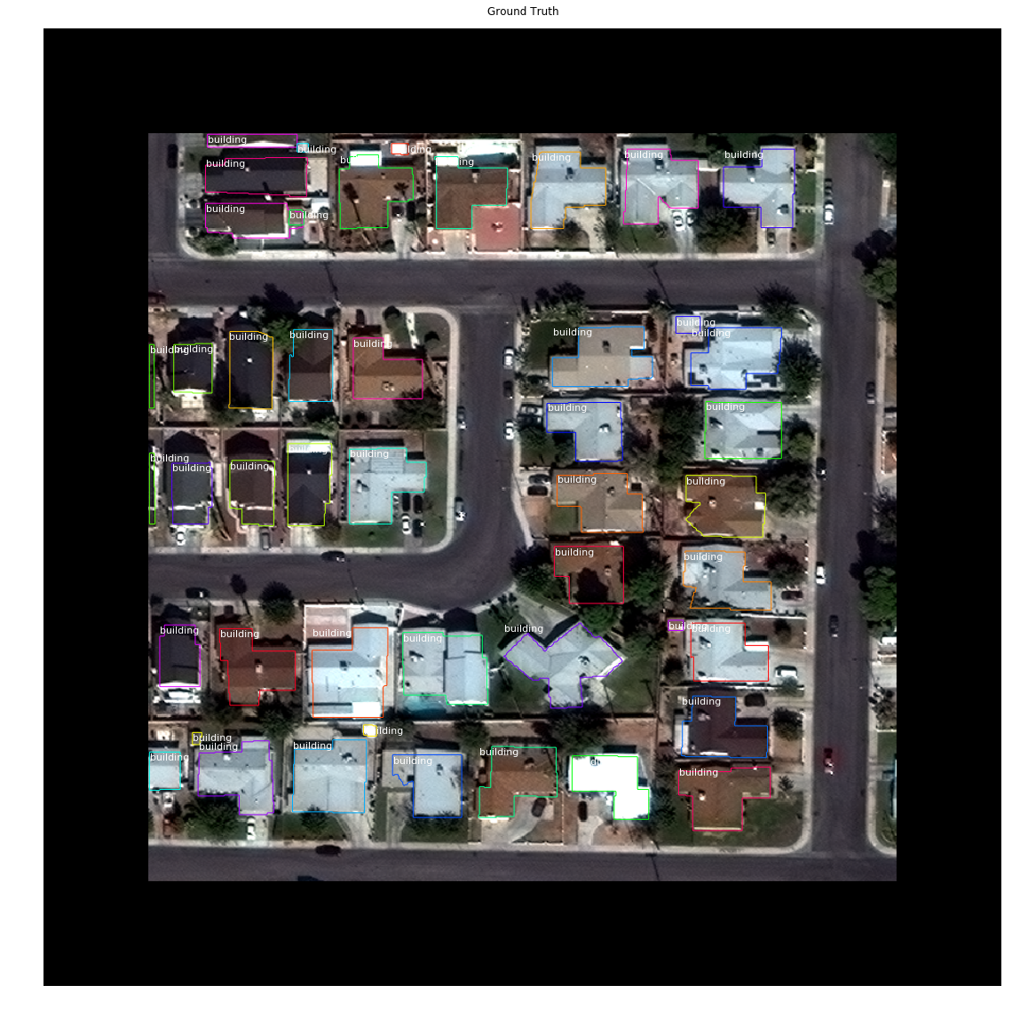
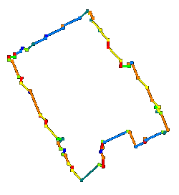
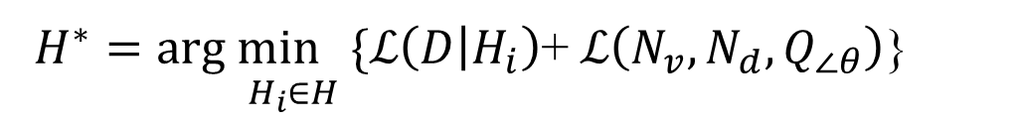
Building Extraction from Satellite Images Using MASK R-CNN with Building Boundary Regularization Kang Zhao, Jungwon Kang, Jaewook Jung, Gunho Sohn Department of Earth and Space Science and Engineering, York University
1. Introduction
2. Methodology
4. Experimental Results
DeepGlobe Building Extraction Challenge (DG-BEC)
The DG-BEC provides satellite images of four urban cities including Las Vegas, Paris, Shanghai, and Khartoum.
There are four types of images including panchromatic (PAN), 8-band multi-channel (MUL), pan-sharpened version of RGB bands from the multispectral product (RGB-PanSharpen), and lastly pan-sharpened version of MUL (MUL-PanSharpen).
The DG-BEC poses the problem of localizing all building polygons in the given images.
Motivation and Our Approach
As a base network, we adopt Mask R-CNN [K. He, 2017] due to its simplicity in the network structure and hyper-parameter tuning.
The MASK R-CNN produces polygon points of each individual building, which normally have irregular shapes.
However, we observe that most of building footprints have regularized boundaries.
Motivated by this observation, we then formulate the problem as the creation of regularized polygons for buildings.
Therefore, we utilize a building boundary regularization method, which is adopted from our previous works [G. Sohn, 2012][J. June, 2017].
Then, we convert (irregularly shaped) polygons generated by Mask R-CNN into the regularized polygons.
Our Pipeline for Building Polygon Generation
Our pipeline is a combination of Mask R-CNN and building boundary regularization.
Given an input image, Mask R-CNN generates initial polygons for buildings.
Then, through our building boundary regularization process, the initial polygons are converted into regularized ones.
Building Extraction Results for Each City
Las Vegas
Mask R-CNN
Building Boundary
Regularization
Paris
Shanghai
Khartoum
Image
[RGB-PanSharpen]
Initial Polygon (Irregularly shaped)
Regularized
Polygon
Details for Implicit Building Boundary Regularization
F1 Scores
* Nofto, Wleite, XD_XD are 3 top ranked methods from SpaceNet challenge
Method | Las Vegas | Paris | Shang- hai | Khar- toum | Total
Nofto | 0.787 | 0.584 | 0.520 | 0.424 | 0.579
Wleite | 0.829 | 0.679 | 0.581 | 0.483 | 0.643
XD_XD | 0.885 | 0.745 | 0.597 | 0.544 | 0.683
Mask R-CNN | 0.881 | 0.760 | 0.646 | 0.578 | 0.717
Ours | 0.879 | 0.753 | 0.642 | 0.568 | 0.713
Two scores from Mask R-CNN and ours are almost equivalent.
However, our method cut off the number of polygon points by 86%, thus dramatically simplified the generated polygons.
These polygons can be directly imported to many applications.
Polygon Quantization
Hypotheses Generation
Model Selection
$\underset{{ H}_{i}∈H}{H^{∗}=arg min} \{ℒ\left(D | H_{i}\right)$+$ℒ\left(N_{v},N_{d},Q_{∠θ}\right)$}
3. Training & Testing Setup
5. Conclusions
For training, we used a pre-trained model trained on the COCO dataset.
It took three days for training the networks for all the cities using one NVIDIA GeForce 1080 Ti.
The dataset is divided into training (80%) and validation sets (20%).
For testing, we ran our pipeline on about 6000 test images.
We present a building extraction method combining Mask R-CNN with building boundary regularization.
Compared to Mask R-CNN that generates irregular shaped polygons, our method produces regularized polygons, which are directly applicable to numerous cartographic and engineering applications.
(Irregularly shaped) Polygons by Mask R-CNN
Regularized polygons
by our method
▫ All the details including hyper-parameters will be posted in our project website:
https://github.com/yorku-ausml/deep_satellite_image_segmentation
Acknowledgements: We would like to acknowledge the supports from Natural Science and Engineering Research Council of Canada (NSERC) Discovery Program and Ontario Research Fund (ORF) - Intelligent Systems for Sustainable Urban Mobility (ISSUM) Program

